Slide 1
Contact management system
Database Management system Mini Project
on
Submitted By:
Arvin Pradhan - ENG17CS0038
A.K. Aravind - ENG18CS0003
Akhilesh S. Bhat - ENG18CS0025

Slide 2
1. ABSTRACT
Contact Management is a console application, made by using python programming language.
User will have to enter the details of the contact inside the form available. Once entered the user can save the name and details of the people inside the database and access it.
The application will use database to save contact number. Name, Gender, address.
If the entries does not make sense to the encoding then the entry will show error
Each entry has its own unique entry

Slide 3
2. INTRODUCTION
The mini project ‘contact management’ is the sample project for maintaining contact details. The project aims at developing contact management system using the python language that enables an organization to maintain its library.
The project demonstrates the creation of a user interface of a system, with the use of python libraries.
The application uses basic function to generate menu, show message box and print text on the screen.
For this project we will be developing a contact management. A contact manager is a software program that enables users to easily store and find contact information, such as names, addresses and telephone numbers.
They are contact-centric databases that provide a fully integrated approach to tracking of all information and communication activities linked to contacts
In this project we will be developing a digital contact management application. The data file will hold contacts to their respective names.
The application will access this data and make it easy to search for names. It will then show the project serial wise in order of addition.

Slide 4
3. PROBLEM STATEMENT
The purpose of this project is to create a digital contact management application that provides easy to use interface and fast search. In general to search for a contact in a list written down, the person has to search for that contact manually. But in a digital management he can simply see the names scrolling down. This is much faster than manually searching for the word in a physical book.
At the end of project, a prototype of justified contact management will be developed which will allow names and numbers in case the entered number and contact is not entered in the database

Slide 5
4. OBJECTIVE
The main objective of this project is to develop a contact application that makes it easy to search for contacts.
This is application will eliminate the time spent on searching for contacts, as computer saves the contact details.
The user can simply enter a contact details and save the details permanently or delete as their wish

Slide 6
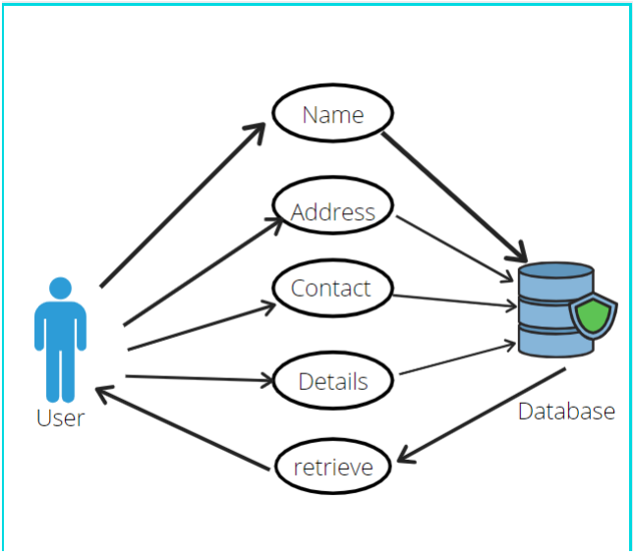
5. Use case diagram

Slide 7
6. Requirements
SOFTWARE REQUIREMENTS
Python3 interpreter with necessary packages installed
Sqlite3
Tkinter
json
Difflib
HARDWARE REQIREMENTS
Computer with 8/4 GB RAM

Slide 8
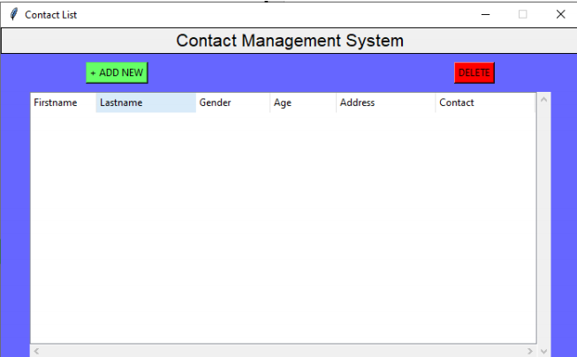
7. OUTPUTS
Main Screen:

Slide 9
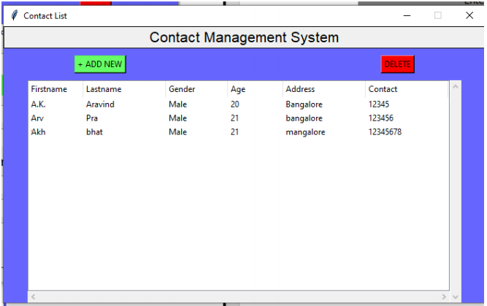
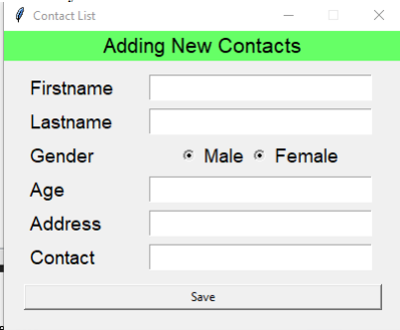
7. OUTPUTS
Contact list
Input box

Slide 10
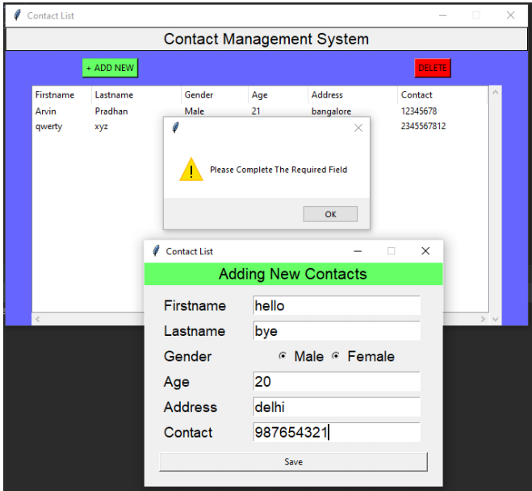
Error message box

Slide 11
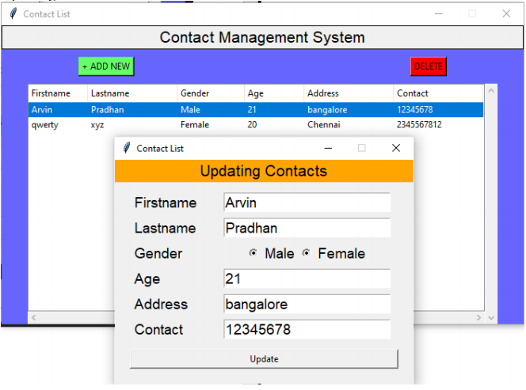
Update Box

Slide 12
8. TEST CASES
For Adding Contact info
SERIAL NO. | TEST NO. | INPUT | OUTPUT | Success | Failure
1. | 1 | Press add contact button | Pops up a window for adding contact | yes | no
 | 2 | Filling up all contact details and press save button | The Details will be stored in the database | yes | no
 | 3 | Leaving some blocks and saving | Popup appear and it wont get saved | no | yes

Slide 13
TEST CASES
For Updating Contact info
SERIAL NO. | TEST NO. | INPUT | OUTPUT | Success | Failure
2 | 4 | Double click on the item | Pops up a window for Updating contact | yes | no
 | 5 | Updating the details and press save button | The Details will be updated in the database | yes | no
 | 6 | Leaving some blocks and saving | Popup appear and it wont get saved | no | yes

Slide 14
TEST CASES
For Deleting Contact info
SERIAL NO. | TEST NO. | INPUT | OUTPUT | Success | Failure
3 | 7 | selecting item and click on delete button | Popup message to confirm the delete action | yes | no
 | 8 | Clicking Delete button without selecting any item | Popup error message saying to select item. | no | yes

Slide 15
9. CONCLUSION
We have successfully built a Contact Manager using python..
The project has been successfully completed. We are able to save contact details.
It saves names, addresses, and gender if required. It stores data in the database of the local system.

Slide 16
Thank You!

